Slide 1
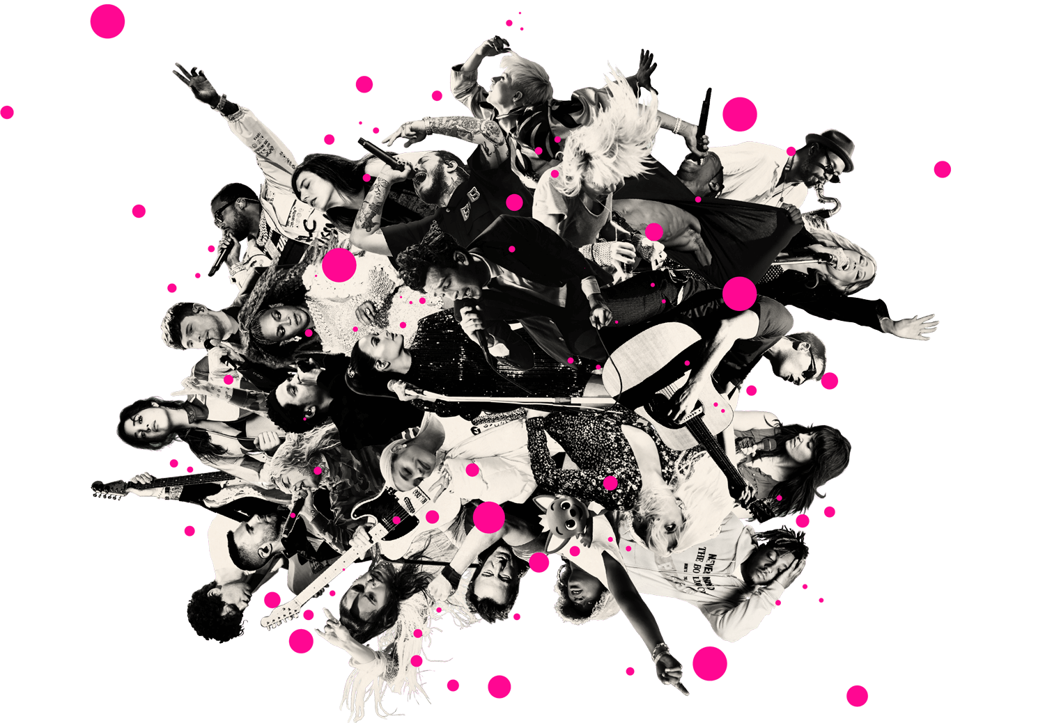
Song Popularity Predictions
Cameron Kilpatrick, Jacob Stegal, Yash Patel, & Yuli Likhonina
Notes:
*YULI

Slide 2


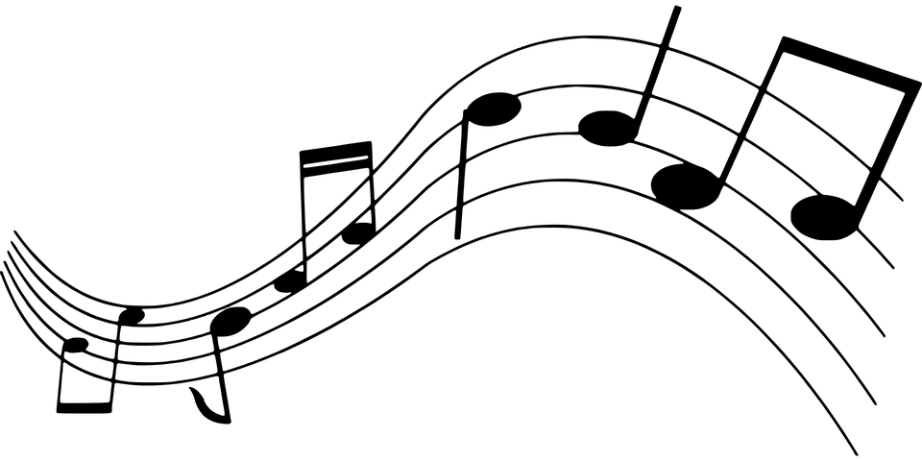
Overview
Motivation:
We music!
Purpose:
Predict the popularity of songs based on attributes
Overall Data Question:
Can future award winners be predicted by using current song attributes?
Notes:
*YULI

Slide 3
Data Set Exploration
What will be the leading genre of music?
Which artist has won the most grammys over time?
What is the correlation between different song attributes?
Notes:
*YULI

Slide 4
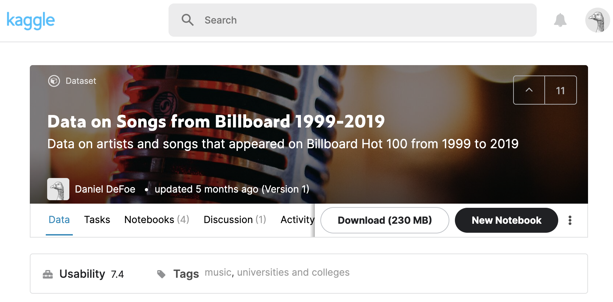
Data Source
Notes:
*YULI

Slide 5
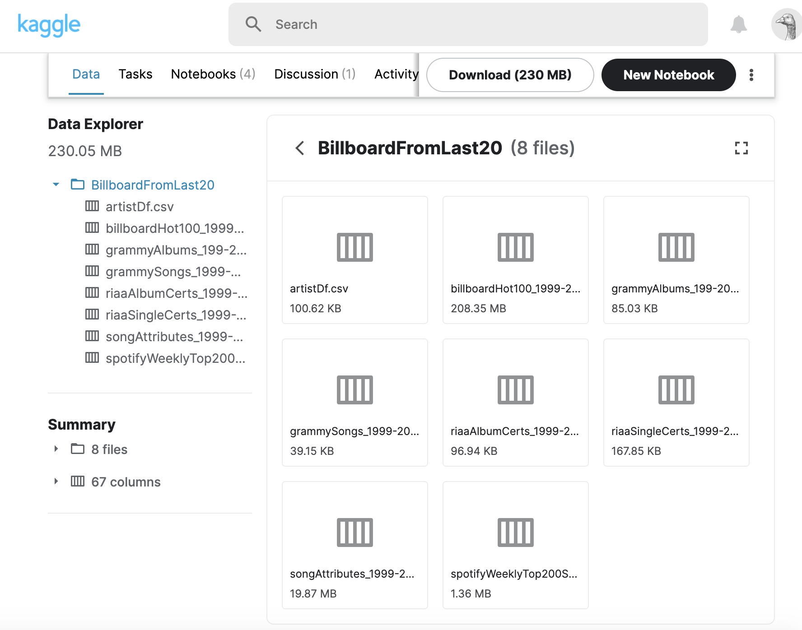
Data Extraction
Notes:
*YULI

Slide 6
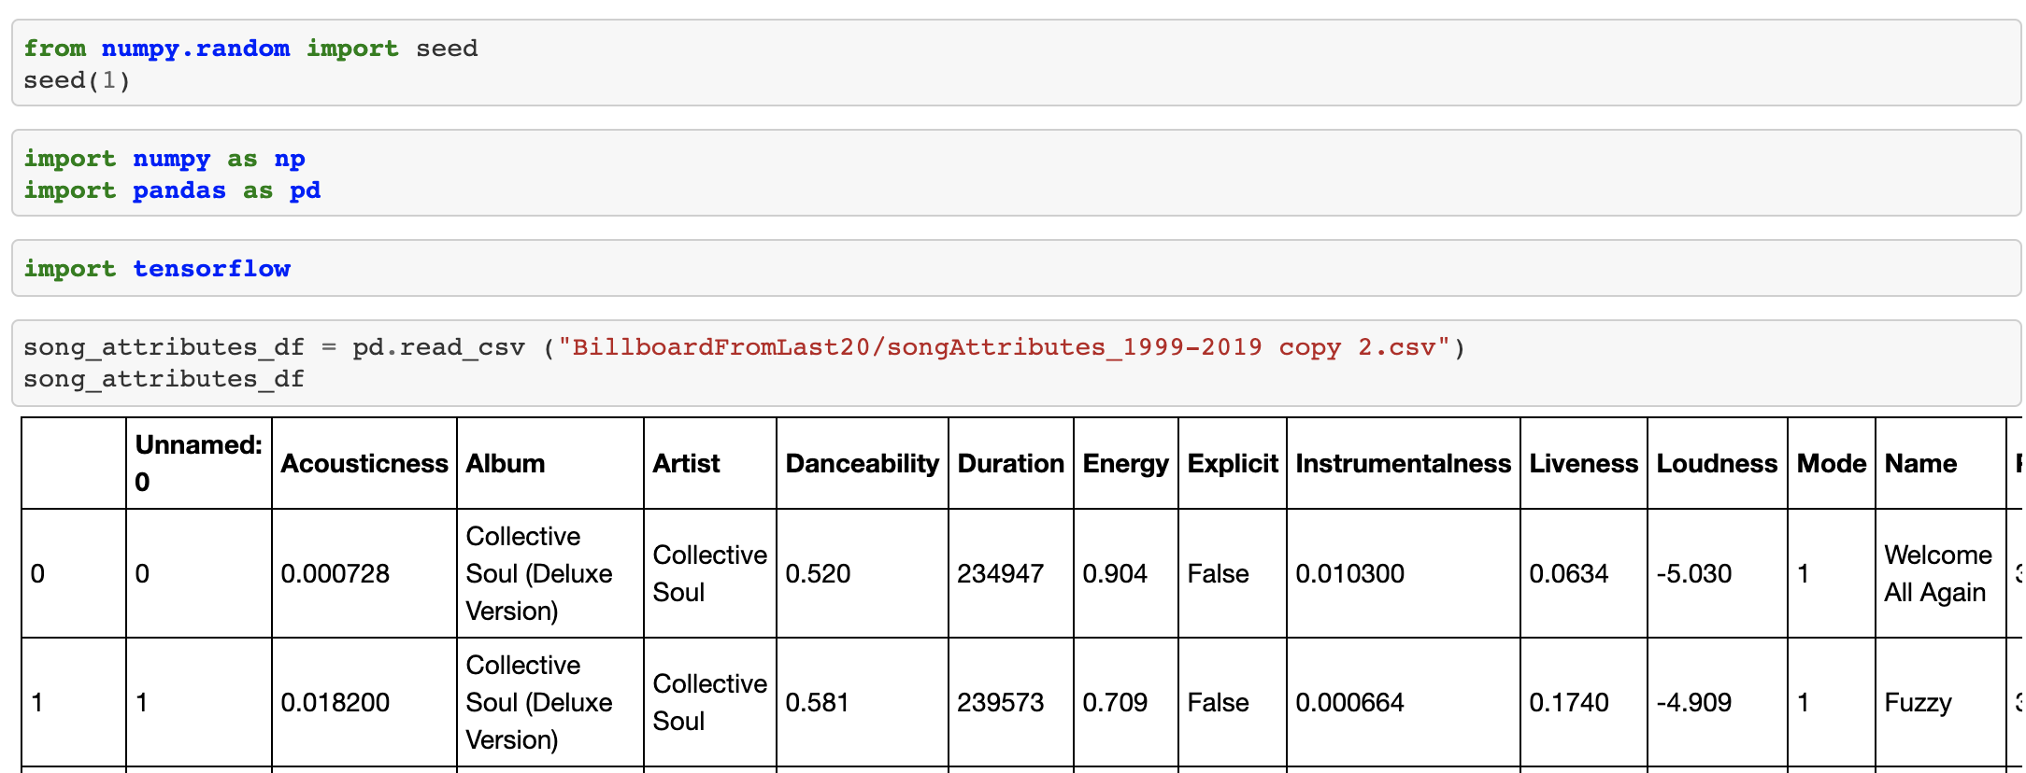
Song Popularity Prediction
Notes:
*JACOB
Import data and reading song attributes, calculated field of popular and unpopular

Slide 7
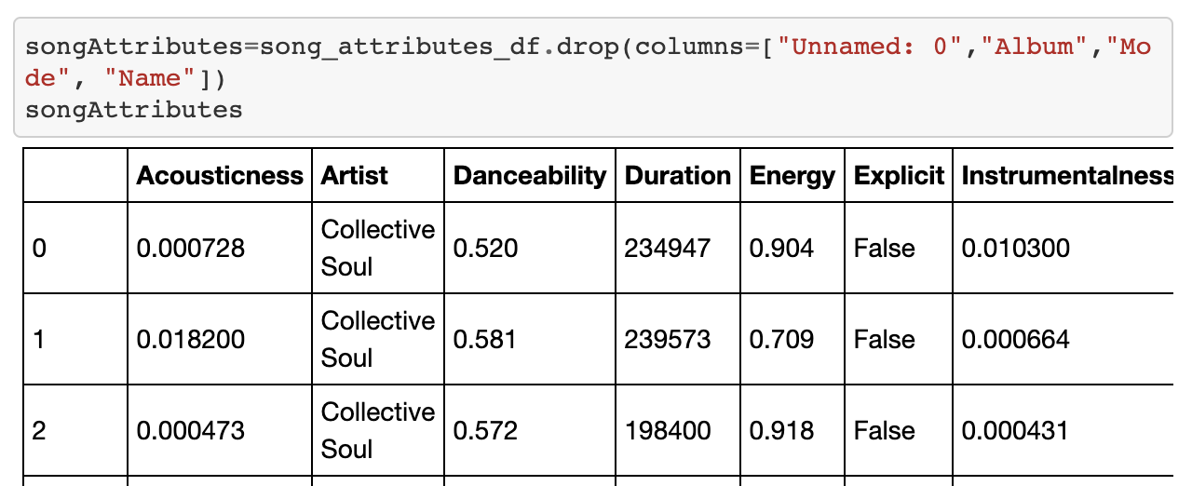
Song Popularity Prediction
Notes:
*JACOB
Dropped the columns that were unneeded

Slide 8
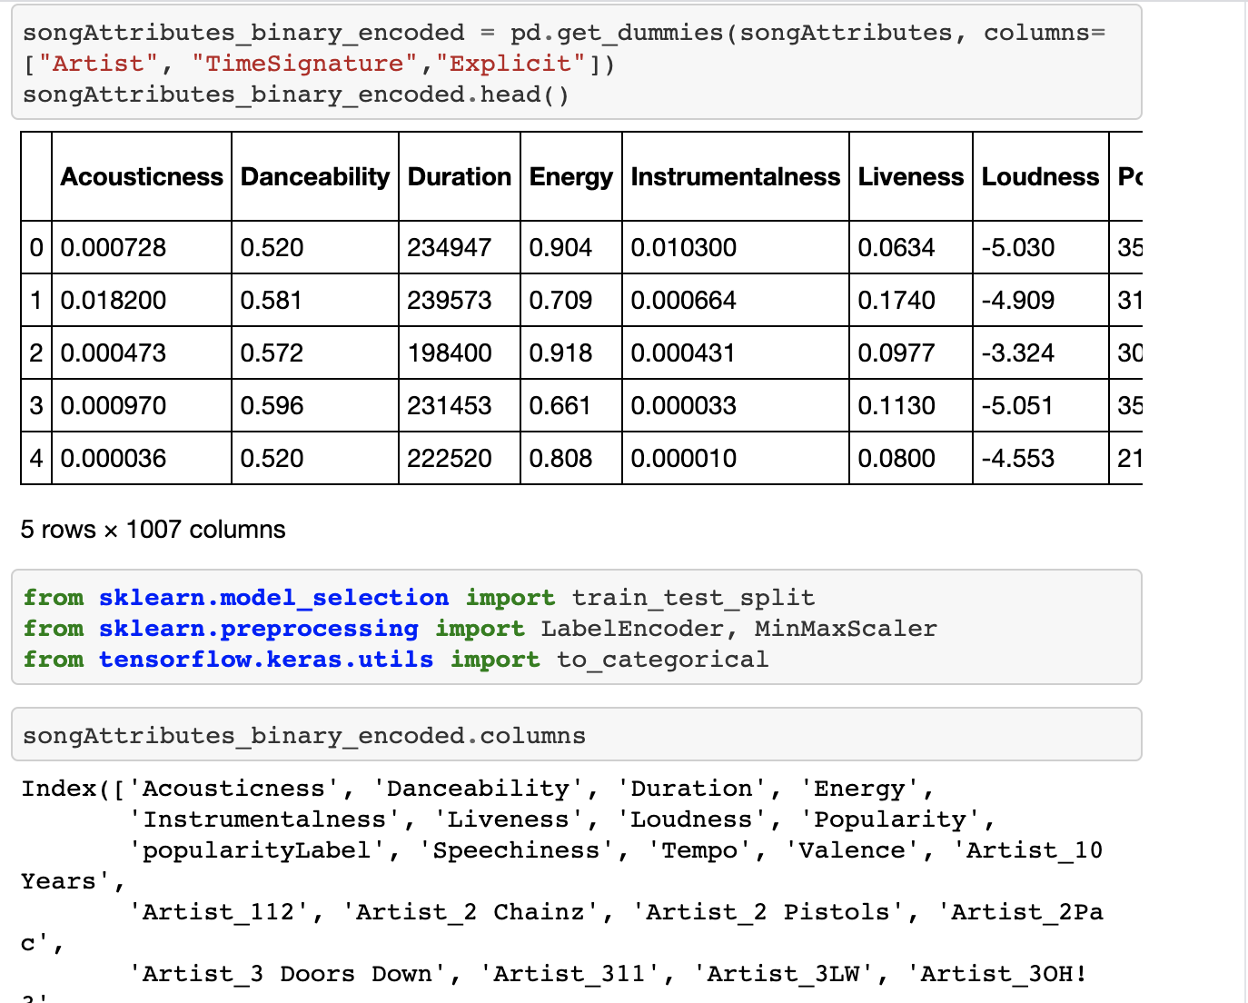
Song Popularity Prediction
Notes:
*JACOB
Encoded data into dummy variables and chose specific columns with no values (Artist/Time Signature/Explicit) since they were not a numerical value we assigned a numerical value. We also imported Sklearn and tensor flow

Slide 9
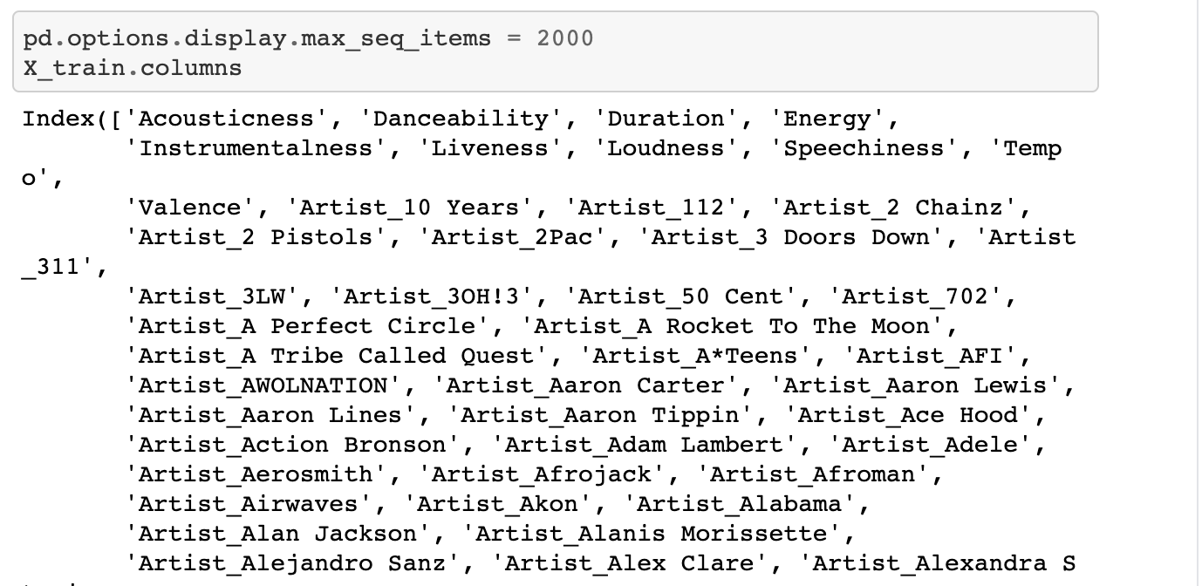
Song Popularity Prediction
Notes:
*JACOB
Lists the columns we dummied previously and showing all variables that we have

Slide 10
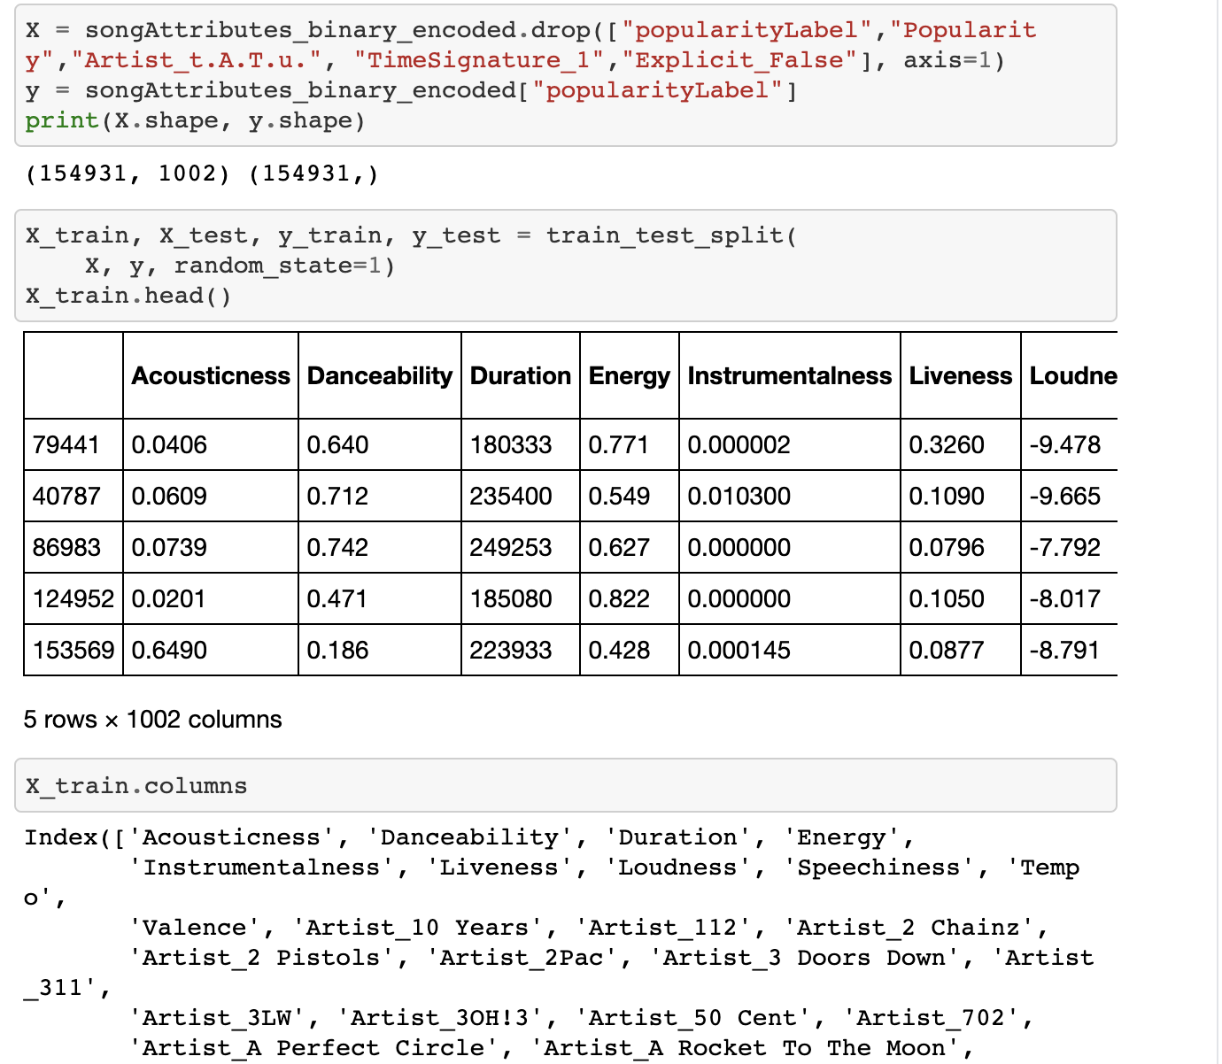
Song Popularity Prediction
Notes:
*JACOB
Added y column of popularity that we are trying to predict and dropped the remaining unneeded columns since we need to drop columns after we dummy. For every dummy variable we dropped one of the columns.

Slide 11
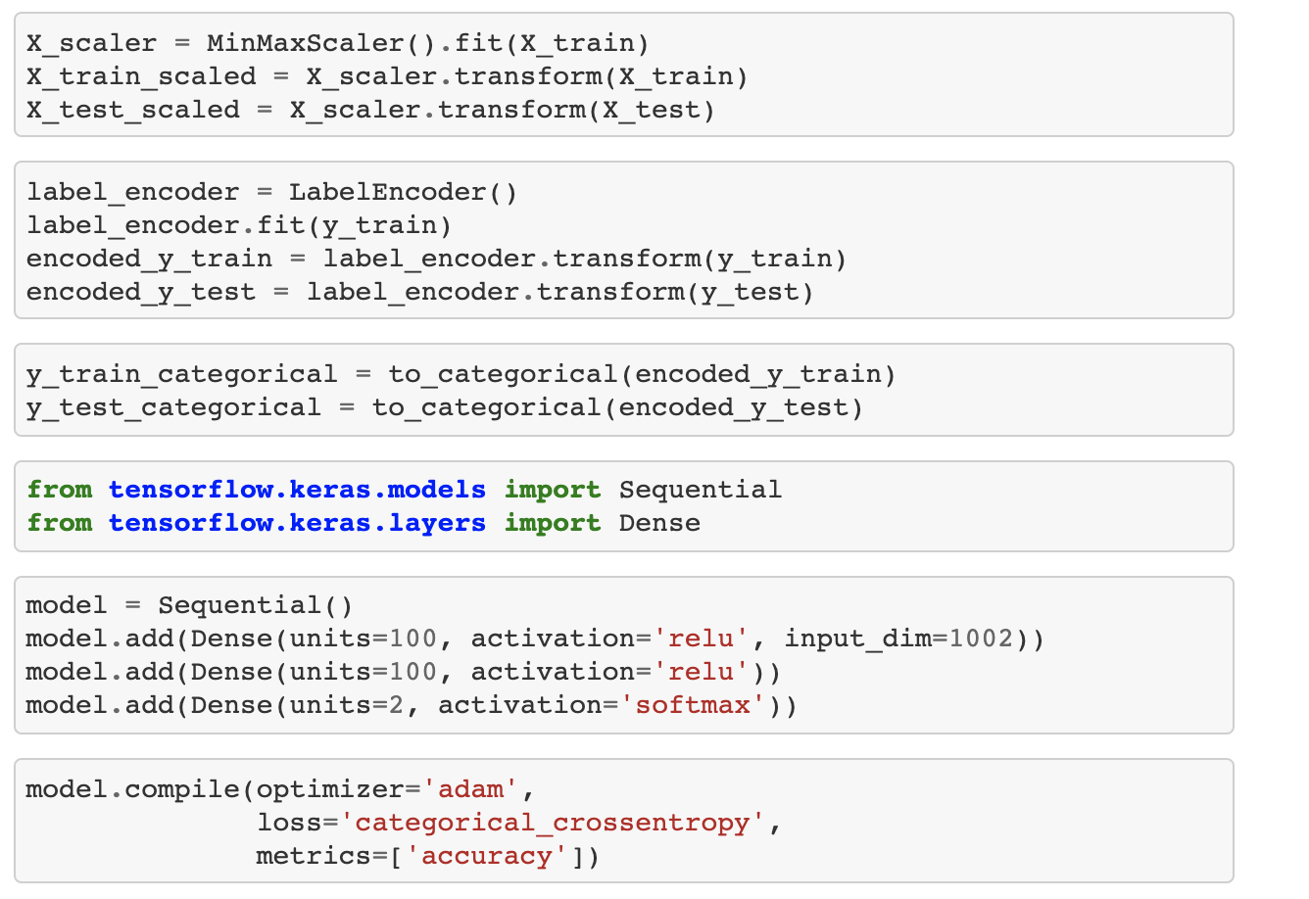
Song Popularity Prediction
Notes:
*CAM
Scaling the model to fit our x train and y train and setting up our model to add layers. The input dimension equals how many columns and rows that we have in our prediction model. The units in the last row are what we are predicting on 2 attributes - unpopular and popular

Slide 12
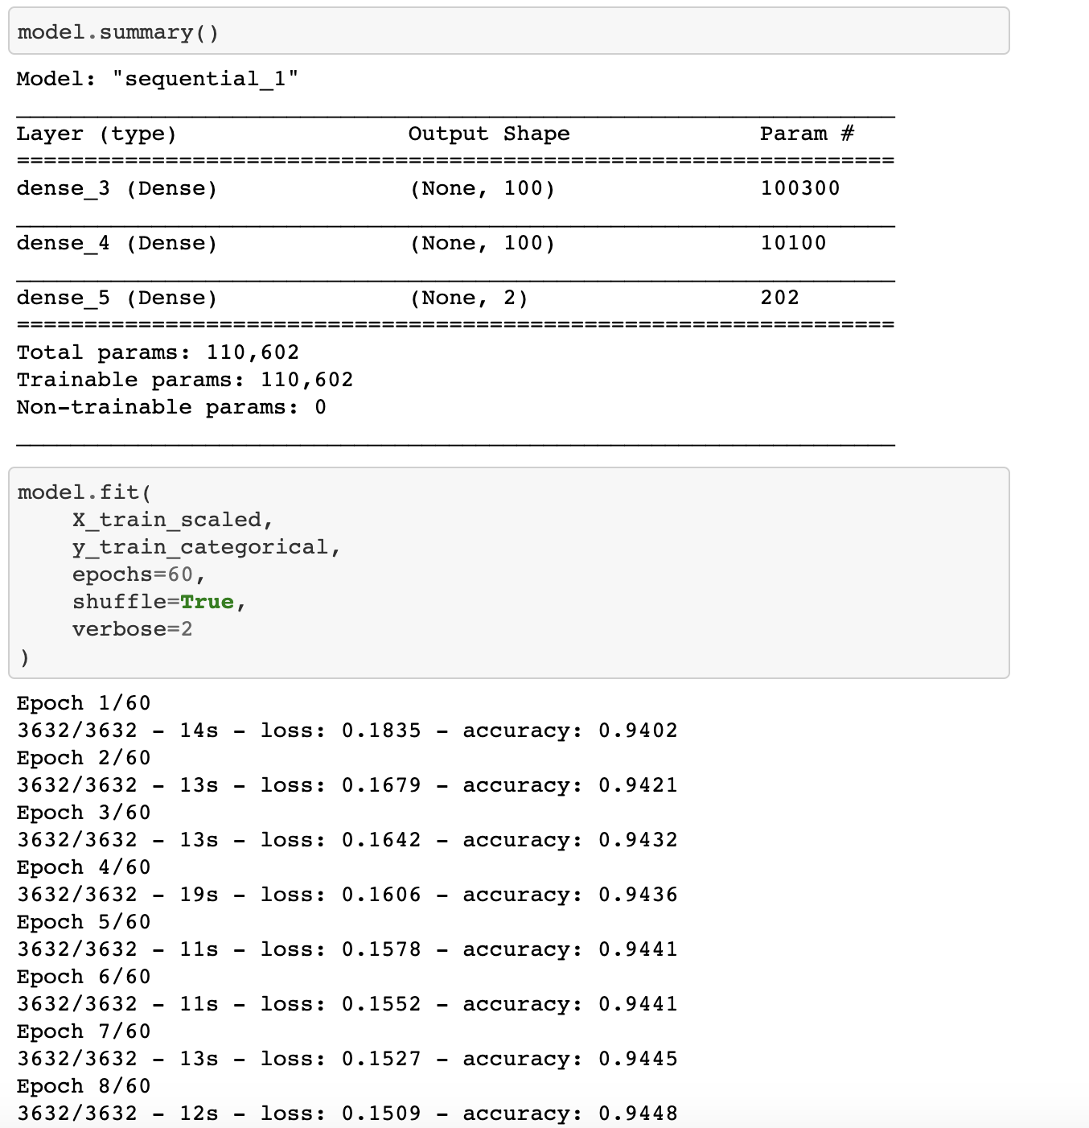
Song Popularity Prediction
Notes:
*CAM
The prediction model that has the model summary and the model fit that goes through each time and predicts. We had an epoch of 60 so it will go through it 60 times to make a prediction

Slide 13
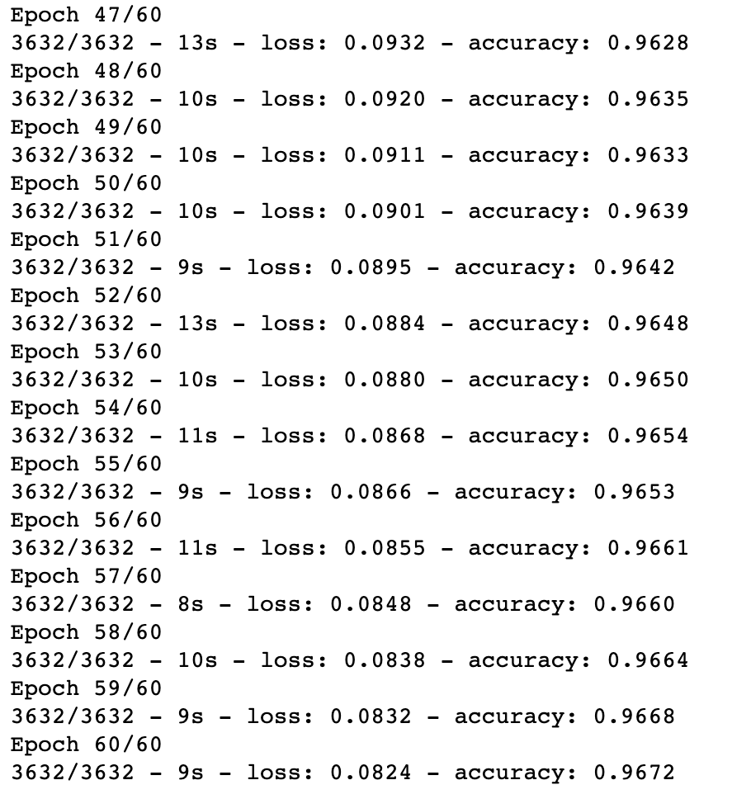
Song Popularity Prediction
Notes:
*CAM
This ran through 60 times to show the final result with an accuracy of 96%

Slide 14
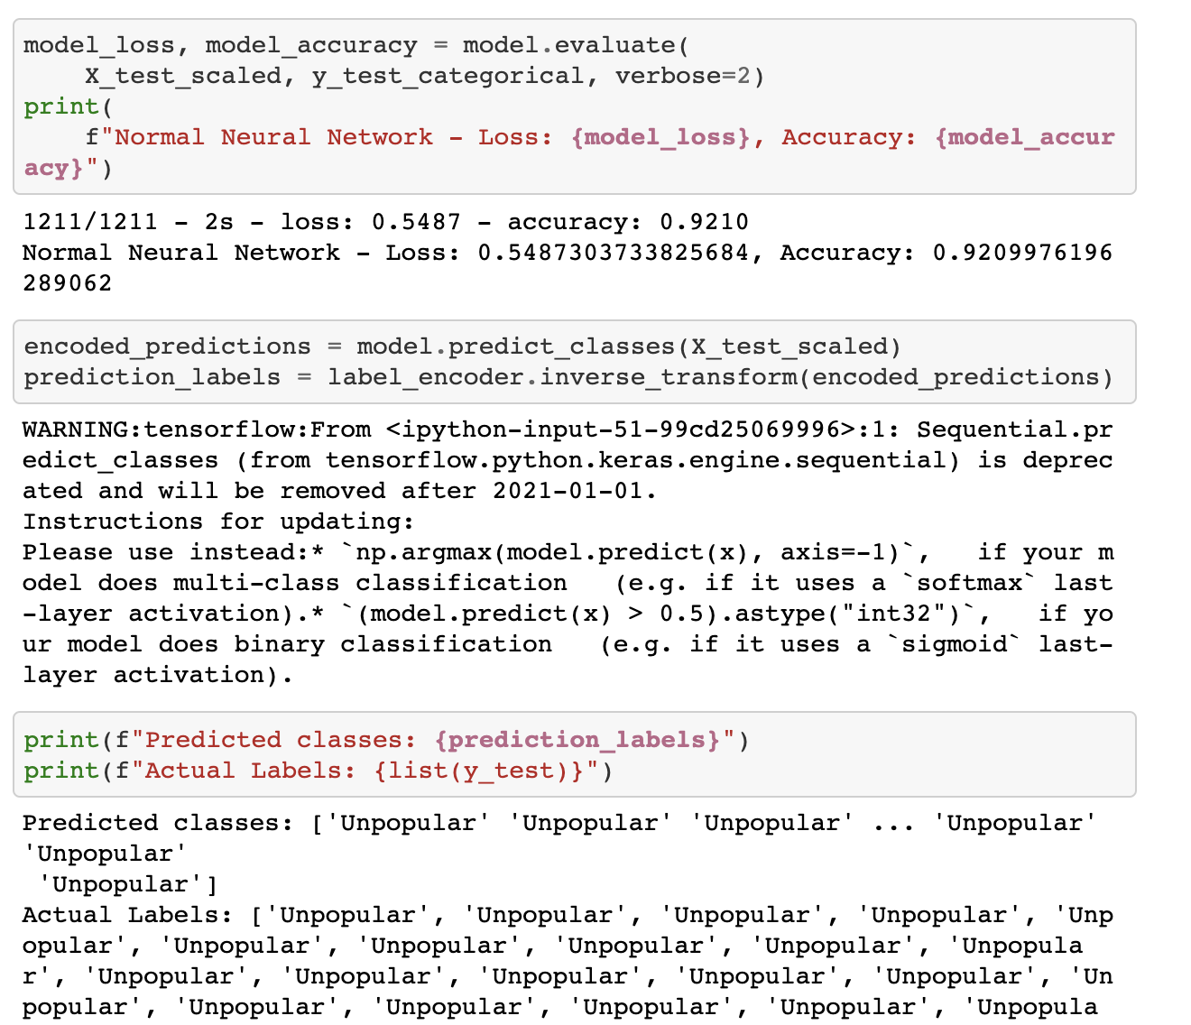
Song Popularity Prediction
Notes:
*CAM
This shows the actual results that we received which is an accuracy rate of 92.1% and a loss of 55%. At the bottom we are printing out the predicted class and actual labels. What the machine is predicting vs our actual values

Slide 15
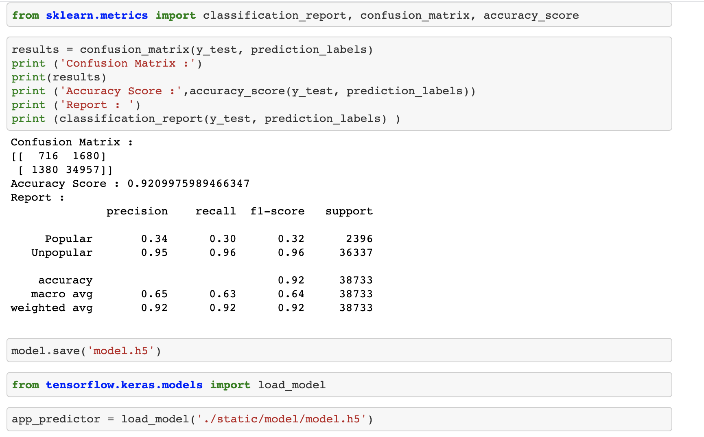
Song Popularity Prediction
Notes:
*CAM
Confusion matrix that shows how accurately the data was predicted. The precision is how widespread it was across the data set. 2396 popular predictions and 36337 unpopular predictions.

Slide 16
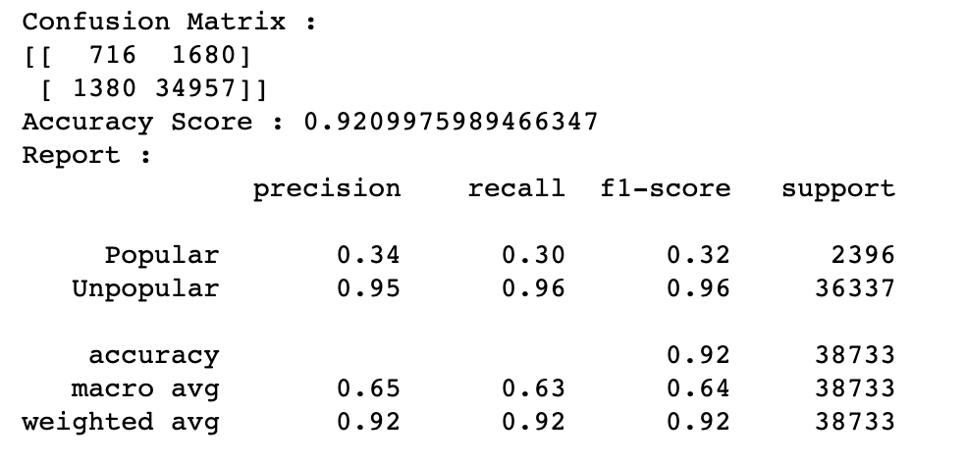
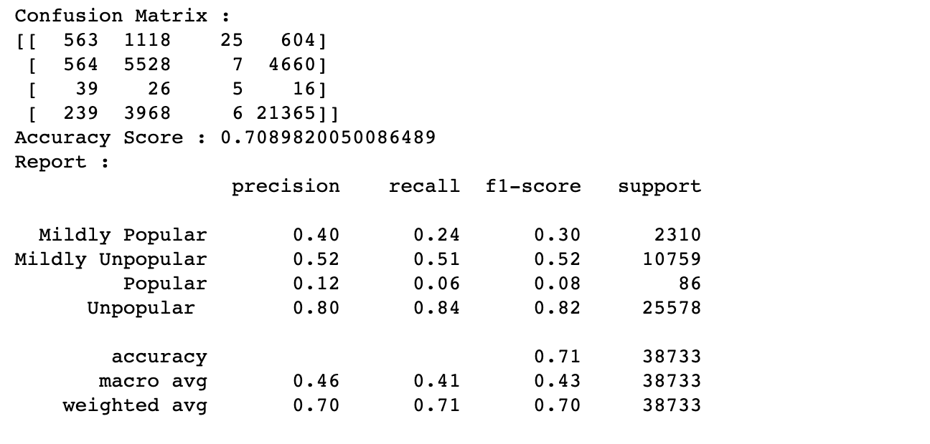
Song Popularity Prediction
Notes:
*CAM
The first confusion matrix we used 4 categories (mildly unpopular, mildly popular, popular, unpopular) performed at a 70% accuracy and the second confusion matrix we used 2 categories (popular and unpopular) and performed at a greater accuracy at 92%. There was a higher accuracy rating with less categories and a lower amount of selections. The higher the selection the lower the accuracy.

Slide 17
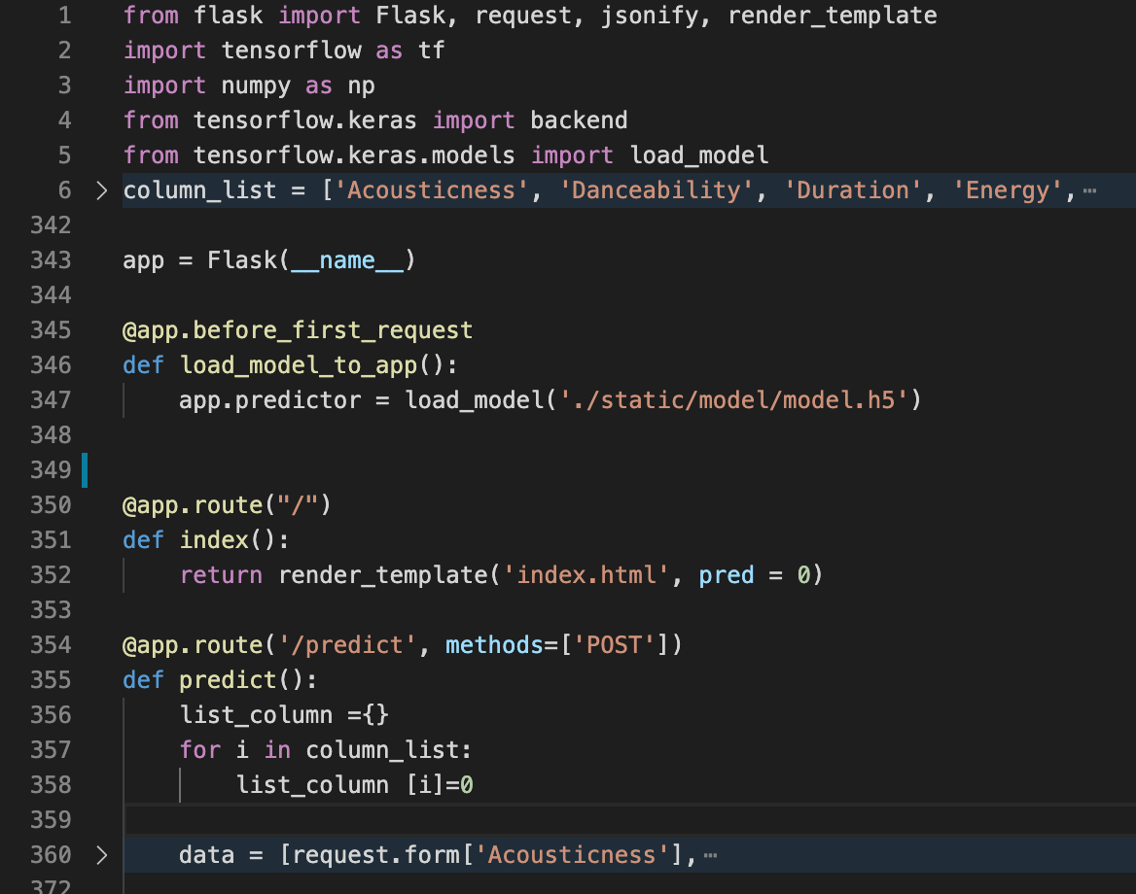
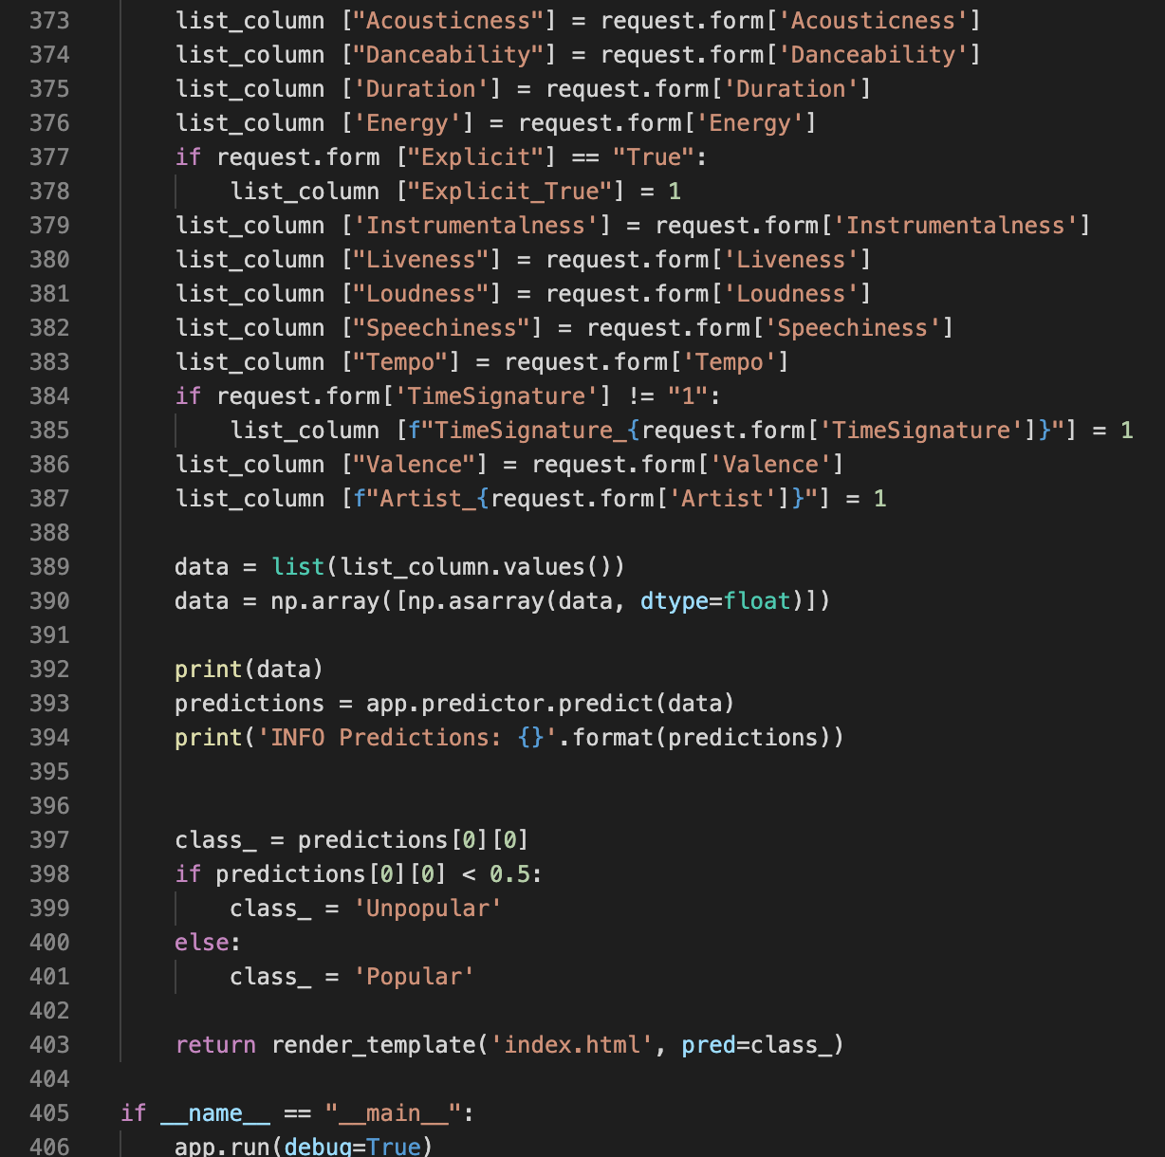
Song Popularity Flask App Code
Notes:
*YASH

Slide 18
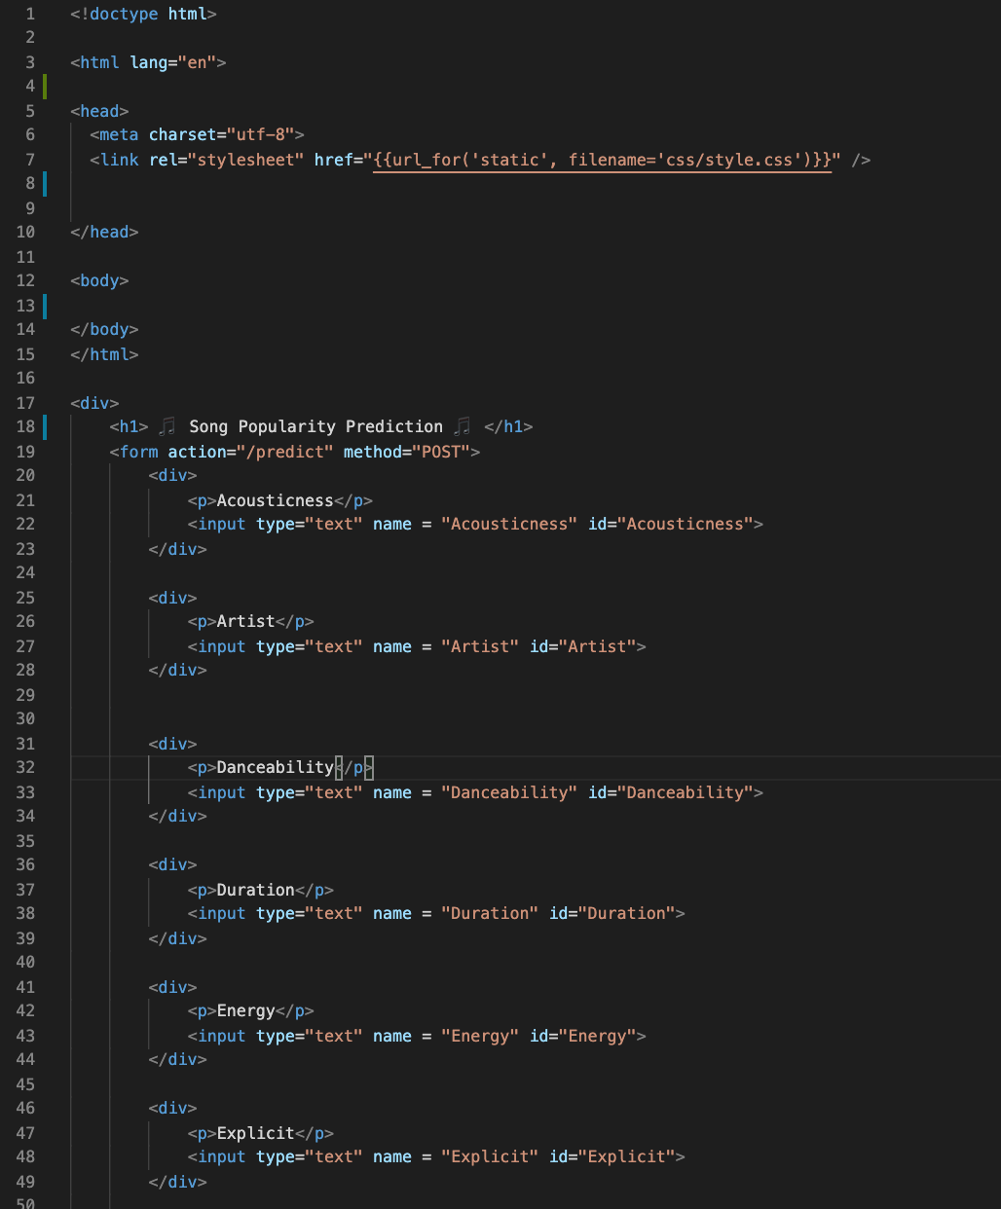
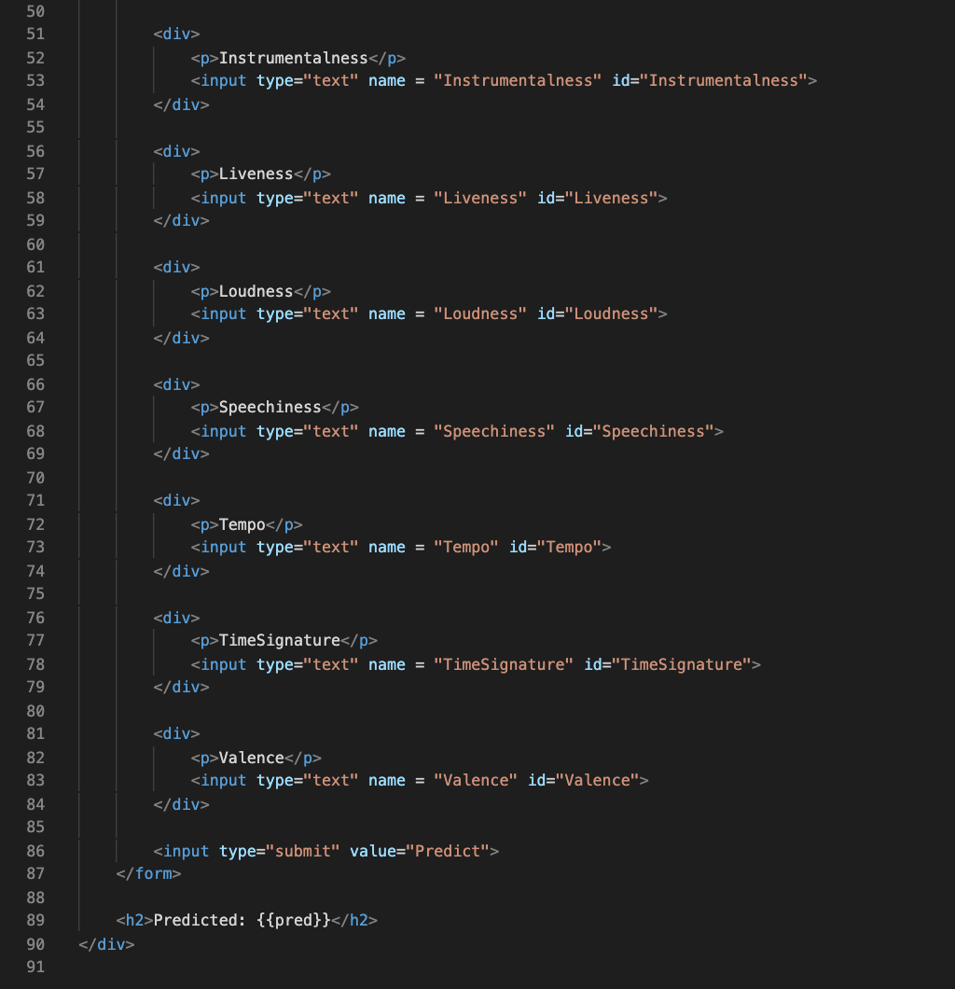
Song Popularity HTML
Notes:
*YASH

Slide 19
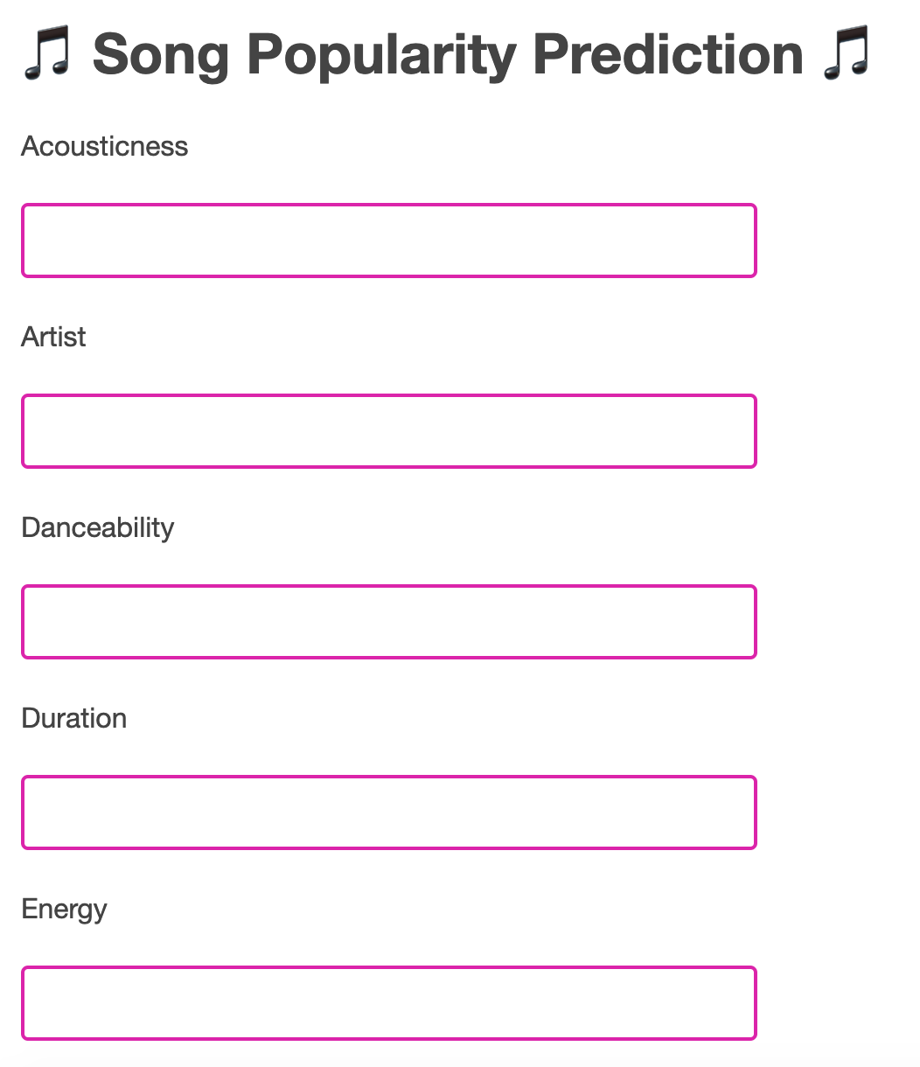
Song Popularity Flask App Page
Notes:
*YASH

Slide 20
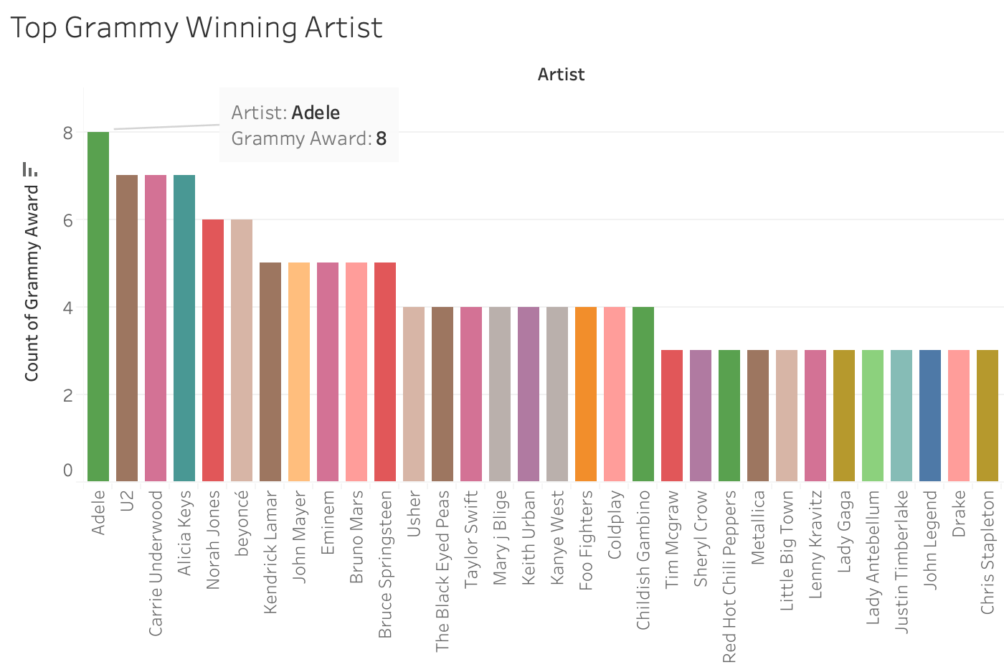
Top Grammy Winning Artists
Notes:
*YULI
According to our dataset, Adele won the most grammys in one night (8) followed by U2, Carrie Underwood, Alicia Keys, and Norah Jones

Slide 21
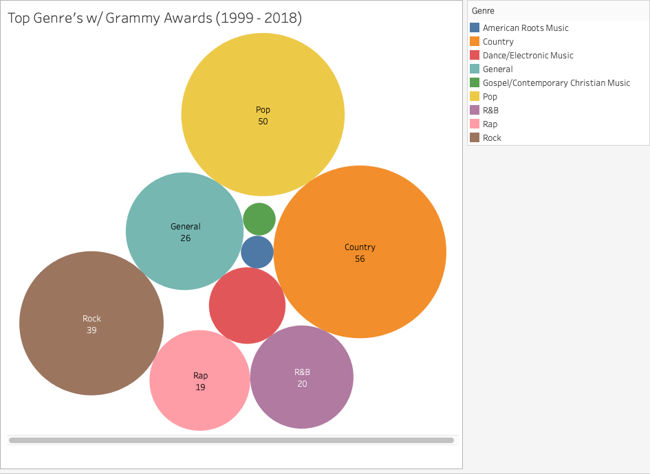
Top Genre Grammy Awards
Notes:
*YULI
Country and pop are the most popular genre grammy awards followed by Rock

Slide 22
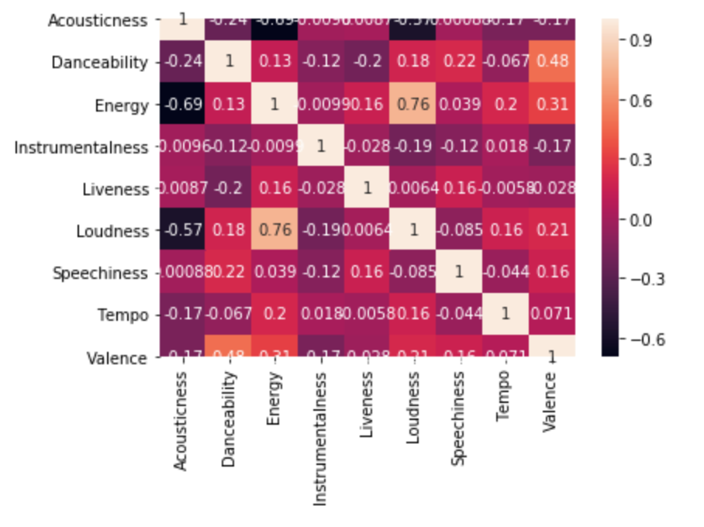
Correlation Matrix
Notes:
*YULI
Correlation matrix with a diagonal line that measures the correlation between two types of different attributes. For example, danceability there is a .48 correlation between that and valence. So the more danceable the song the more valence it has. The second strongest correlation is between loudness and energy. Provides a visual of the correlation between different types of attributes.
Valence: Describes the musical positiveness conveyed by a track. Tracks with high valence sound more positive (e.g. happy, cheerful, euphoric), while tracks with low valence sound more negative (e.g. sad, depressed, angry).

Slide 23
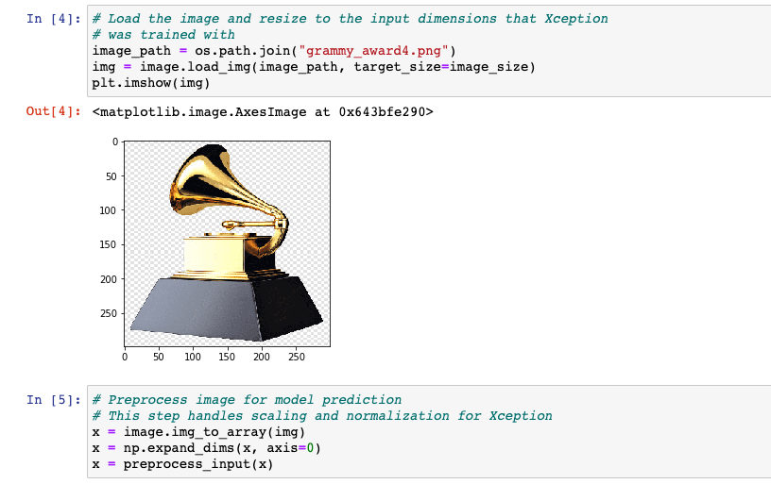

What is a grammy?
Notes:
*JACOB

Slide 24
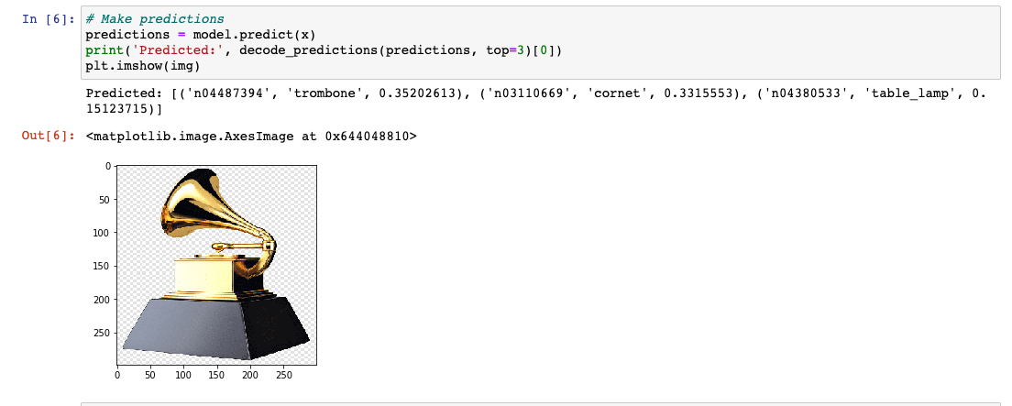
What is a grammy?
Notes:
*JACOB

Slide 25
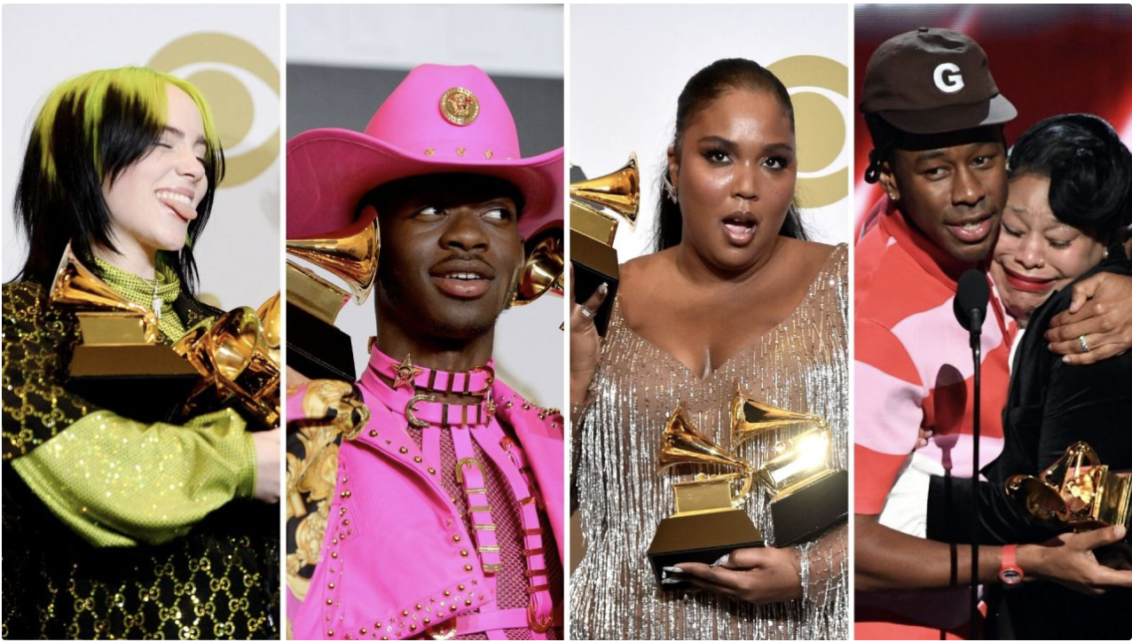
Top 2020 Grammy Award Artists
Notes:
*JACOB
Billie Eilish (Pop/Electropop), Lil Nas X (Hip Hop/Rap), Lizzo (Hip Hop) and Tyler the Creator (Hip Hop/Rap)were big winners at the 62nd Grammy Awards on January 26, 2020 in Los Angeles

Slide 26
Musical Data Conclusions
What will be the leading genre of music?
Country
Which artist has won the most grammys over time?
Adele
What is the correlation between different song attributes?
Loudness & Energy
Danceability & Valence
Notes:
*YASH
Will also explain the overall question and how we couldn’t answer but will answer it in the future
Q: Can future award winners be predicted by using current song attributes?

Slide 27
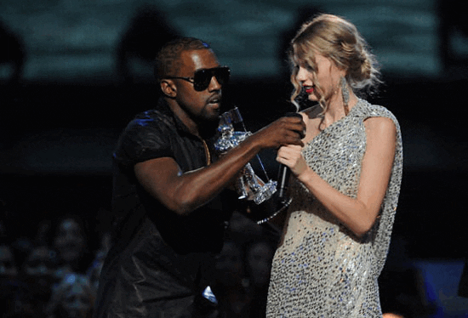
Q&A
Notes:
*YASH

